Slide 1
Water scarcity
Meaning
Causes
Effects
solutions

Slide 2
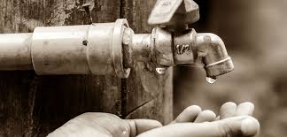
meaning
Scarcity of water means shortage of water, an imbalance between demand and supply.

Slide 3
causes
Pollution
Overuse of water
Wastage of water
drought

Slide 4
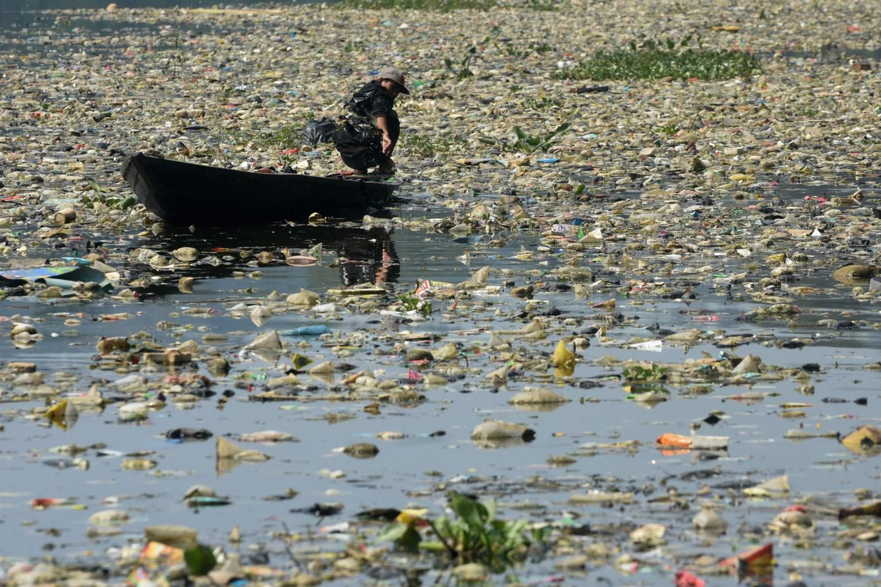
1. pollution
pollution is a major cause of water shortage. Water is polluted when industrial wastes are deposited into water bodies thus making it unfit for human consumption. Oil spillage and fecal matter also makes the water contaminated. It cannot be used for drinking which makes it scarce.

Slide 5
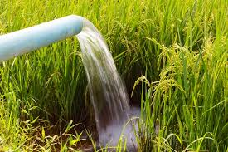
2. Overuse of water
when water is overused, shortage occurs. some people use too much water especially for irrigation purposes. It, therefore; becomes inadequate for other equally important uses.

Slide 6
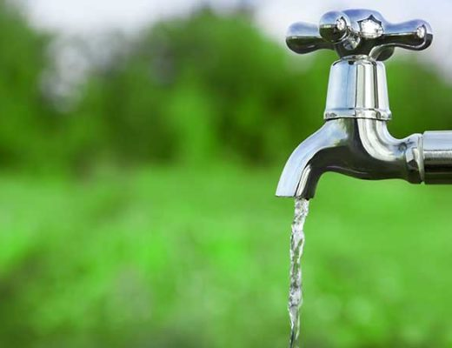
3. Wastage of water
wastage of water is also a major cause of water shortage. Some people leave their taps running even when they are not fetching water. All this is lost to the ground. The resultant problem is lack of enough water.

Slide 7
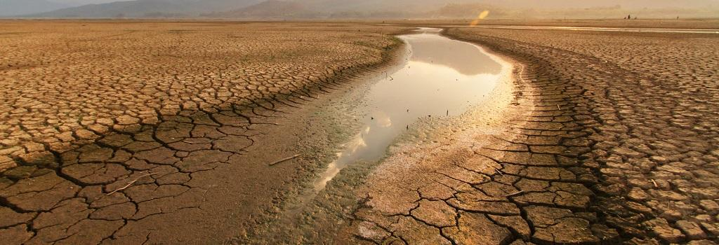
4. drought
When drought strikes an area, there is usually no rain for a long period of time. this makes rivers to go dry. Other water sources such as streams, ponds, lakes also dry up. People, therefore; do not have enough water for domestic and industrial use.

Slide 8
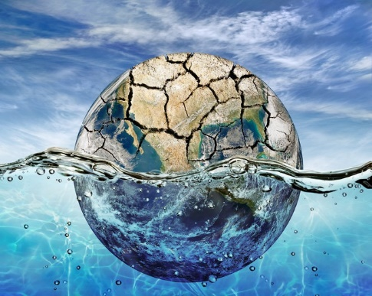
effects
lack of adequate drinking water.
hunger.
Diseases and parasites.
Sanitation problems.
lack of education.

Slide 9
solutions
people should be educated on the benefits of conserving water.
laws should be enforced to prevent water pollution. Those found polluting water should be fined or given a penalty.
people should recycle rain water.
people should contribute funds to support clean water initiatives especially in area that face water shortage.
water catchment areas should be preserved.

Slide 10
We never know the worth of water till the well is dry.
-Thomas fuller
The end

